Slide 1
THE FUTURE OF FINANCIAL SERVICES THROUGH MY EYES
Dr Iyandra P Bryan

Slide 2
FUTURE OF FINANCIAL SERVICES
“You have to be a good pastist, to be a good futurist.”

Slide 3
Financial services is facing a loyalty crisis
Wealth Mgmt
50%
attrition rate in wealth transfers*
70%
of policyholders are having negative experiences***
72%
of customers would rather bank with Google, etc.**
Banking
Insurance

Slide 4
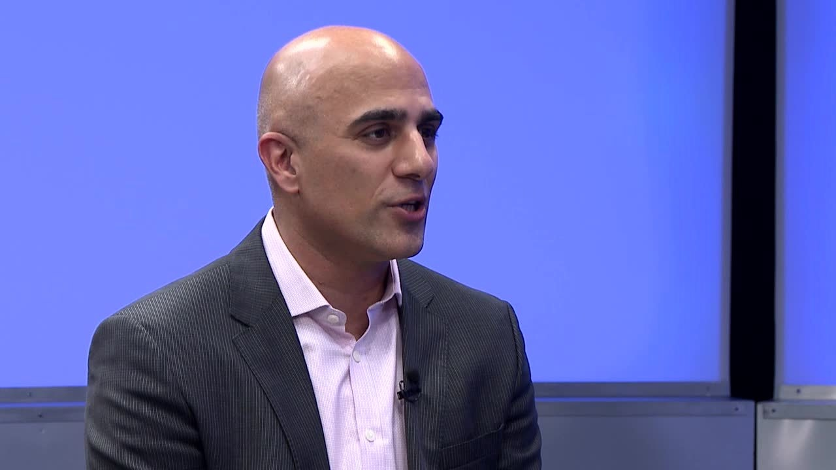
Future of Financial Services
“Financial services is facing a massive loyalty crisis. Customers are no longer loyal to institutions, but to experiences.”
- Rohit Mahna
General Manager, Salesforce

Slide 5
Future of Financial Services: “CONNECTING” WITH OUR CLIENT, NOT MERELY KNOWING OUR CLIENT

Slide 6
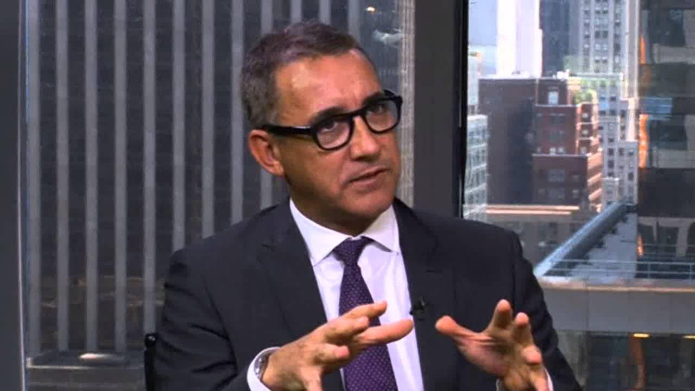
Future of Financial Services
“10 years ago, the entire industry viewed its clients as walking wallets. But what if they aren’t?”
- Joe Duran
CEO, United Capital

Slide 7
Future of Financial Services: “CONNECTING” WITH OUR CLIENT, NOT MERELY KNOWING OUR CLIENT
44%
of Gen Xers (35 – 54 years) recently switched advisers as they didn’t agree with their advice*
Client’s Needs
Client’s Objectives
Client’s Desires

Slide 8
Future of Financial Services: EMPLOYEE PRODUCTIVITY
79%
of relationship managers say applications need improvement.
EMPLOYEE PRODUCTIVITY
is the #1 growth strategy for wealth mgmt. firms in 2016*

Slide 9
Future of Financial Services: EMPLOYEE PRODUCTIVITY
79%
of relationship managers say applications need improvement.
EMPLOYEE PRODUCTIVITY
is the #1 growth strategy for wealth mgmt. firms in 2016*

Slide 10
Future of Financial Services: ALTERNATIVE / NONTRADITIONAL FINANCIAL SERVICE PROVIDERS
=> Weak Points and Inefficiencies
Drive Alternative and Nontraditional Financial Service Providers

Slide 11
Future of Financial Services
“Silicon Valley is coming!”
- Jamie Dimon
CEO, JP Morgan Chase

Slide 12
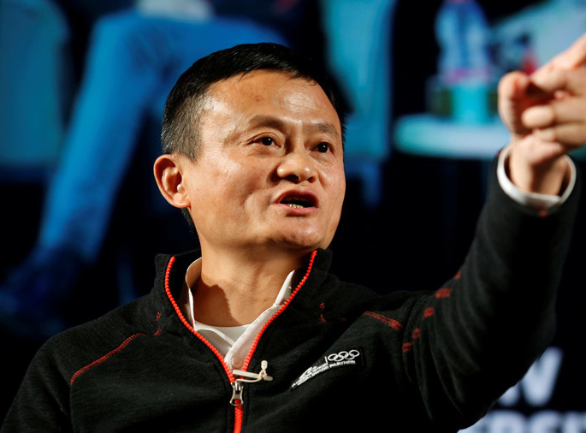
Future of Financial Services: innovation and digitalization
=> Seek out the pain points in our current business models, and alleviate and cure them to pave way for the future.
=> It’s not just about inserting technology into the Bank. It’s about utility and value to the customer.

Slide 13
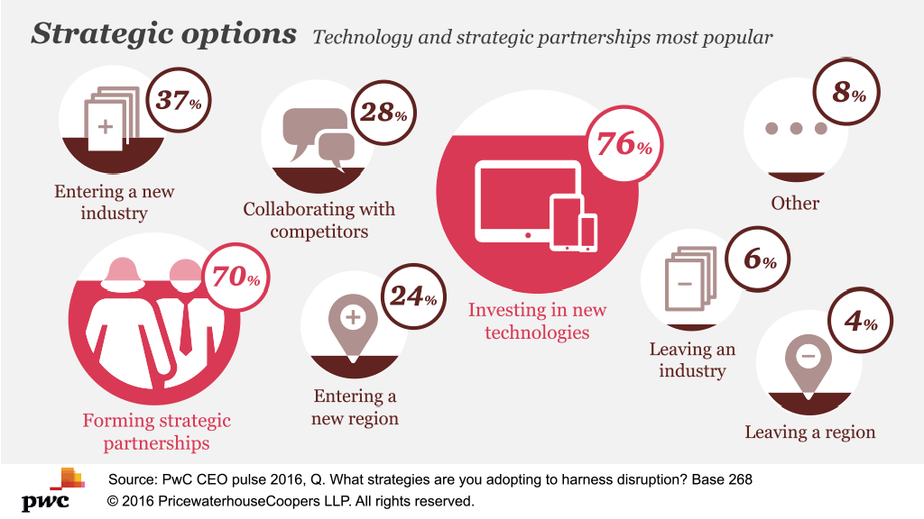
Future of Financial Services: innovation and digitalization
“Four in five CEOs think the production technologies their companies use will change in the next five years (this rises to 90% of CEOs in Asia Pacific companies). And three quarters cite investing in new technologies as the most important strategy for managing disruptions in general.”*

Slide 14
Future of Financial Services
“Our customers are changing. Digital transformation is no longer an option – IT IS A MUST!”
- Henri de Castries
Former CEO, AXA

Slide 15
Future of Financial Services
“Disruptive forces continue to shape our industry. There has never been a more exciting time to transform our entire client relationship.”
- Joe Duran
CEO, United Capital

Slide 16
FUTURE OF FINANCIAL SERVICES: Global Transparency & Automatic Exchange
Foreign Account Tax Compliance Act (US)
Common Reporting Standard (OECD)
Base Erosion and Profit Shifting, Action 5
Register of Beneficial Owners Bill, 2018, Bahamas
Multinational Enterprises Bill, 2018, Bahamas
Knowledge of Laws in Client’s Tax Residence
Collaboration with Advisers in Client’s Tax Residence

Slide 17
FUTURE OF FINANCIAL SERVICES: SKILLED HUMAN CAPITAL
50%
of customers are dissatisfied with their relationship managers’ ability to meet their needs*
Able to advise client on global regulatory developments
Possesses knowledge of client’s tax jurisdiction laws and regulations, at a high level
Full collaboration with client advisors
Able to effectively connect with the client
Able to effectively manage the relationship with the client and anticipate client’s needs and objectives

Slide 18
FUTURE OF FINANCIAL SERVICES: VALUE PROPOSITIONS
Succession Planning
Asset Protection
‘Full Toolkit of Solutions”
High Levels of Customer Service and Standard of Excellence

Slide 19
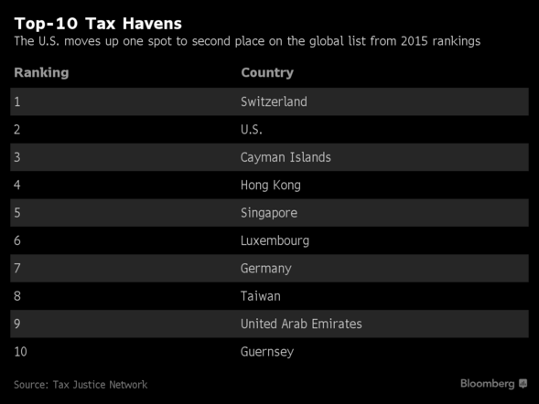
FUTURE OF FINANCIAL SERVICES: ADAPTING TO CONTINUED PRESSURE AND COMPETITION FROM ONSHORE JURISDICTIONS AND LESS TRANSPARENT JURISDICTIONS
1. Repatriation of Assets to Onshore Jurisdictions
2. Creation of Onshore Entities
3. Creation and Transfer of Business to Less Transparent Jurisdictions
DIFFERENTIATION NECESSARY

Slide 20
Future of Financial Services
“With the emergence of the Kindle in 2007, we knew that our business was under threat and that the growth was going to be in the digital area. Yet we had no capabilities in the organization in that area. We needed to figure it out: How do we become relevant and get a footing in where the growth was going to come from—while we continue to preserve the stores as one of the leading retail destinations in their communities? What we really spent time doing is defining who we are and what we do for a living. In digital, we’re now 27% of the e-book market. We have grown faster than we thought, but it’s also been more expensive than we thought [to compete against Amazon]. Transformation and change are really hard. It’s hard financially and it’s hard culturally. But there is no longer a worry about our survival.”
- William Lynch
Former CEO, Barnes and Noble

Slide 21
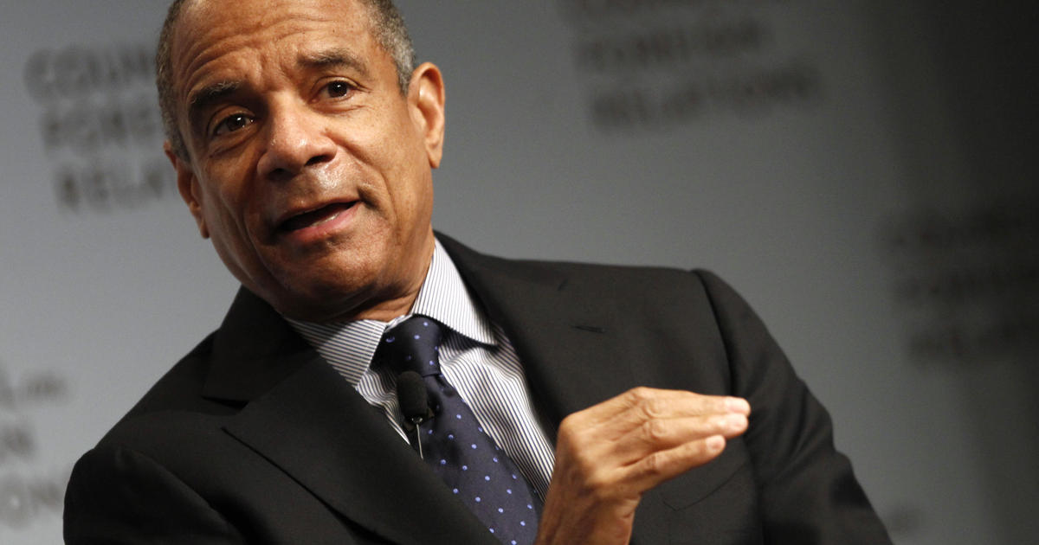
Future of Financial Services
“The most important thing for any company is CHANGE. The test of a true leader is how you manage the business in challenging times. You either INNOVATE or you DIE!”
- Ken Chenault
Former CEO, American Express
Board Member, Facebook
Board Member, UBER

Slide 22
FUTURE OF FINANCIAL SERVICES
Innovation and Digitalization
Value Propositions/Differentiation
Skilled Human Capital
Client Relationship Management as Driving Force

