Slide 1
AIBT Nassau Conference Bootcamp Family Offices
Ryan Pinder
GrahamThompson

Slide 2
Family Offices
What is a family office?
The term “Family Office” covers all forms of services involved in managing wealth for high net worth individuals and families.
The office is created by a family to manage its investments and financial affairs, including investments entities, trusts, foundations and other wealth holdings vehicles.
A family office is normally structured as a separate, stand alone company to limit its legal liability and protect privacy.
It requires a skilled staff for its administration and may also contract with external firms for services like investment advisory, asset management, legal and risk management.

Slide 3
Family Offices
What is a family office?
A vehicle that provides a wide array of functions and services for the family it represents, inclusive of:
staff management,
travel management,
oversight and supervision of financial planning structures
Sometimes can be Regulated
Cross-border regulatory and tax management of family businesses
Charitable Giving

Slide 4
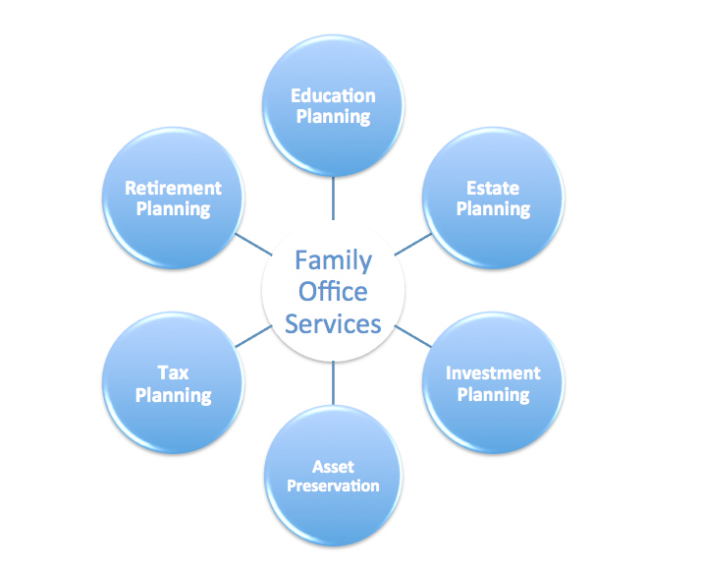
Family Office Functions

Slide 5
Family Office Services
A family office should perform services tailored to the specific needs of a family – proactively anticipating what lies ahead so a client doesn’t have to shoulder this burden.
The family office might assume the day-to-day administration and management of a family’s affairs, and often extends beyond traditional wealth management functions to include family governance, full concierge services and specialty asset advisory such as real estate, art and precious stones.
As the complexity of a family’s circumstances increases, family support services or “lifestyle management” becomes more important, and private banking professionals work with a client to determine the right solution to meet their family’s needs.

Slide 6
Types of Family Offices
Single Family Office
A single family office manages the affairs of a single family.
Multi Family Office
A multi family office manages the affairs of a multiple families which are not necessarily connected. This type is more commercial and many single family offices become multi family offices to reduce the high operating costs of a family office.
Virtual Family Office
Family office services offered virtually – for those who might not have the assets to justify a single family office
Outsourced activity

Slide 7
Types of Family Office Services
Investment Management Services
This is normally the main reason to set up a family office.
Services include:
Evaluating the overall financial situation
Determining investment objectives and philosophy of the family
Determining risk profiles and investment horizons
Asset allocation
Supporting banking relationships
Managing liquidity of the family
Life Management and budgeting
These “concierge” type services include:
Management of holiday properties, private jets and yachts
Club memberships
Budget services

Slide 8
Types of Family Office Services
Philanthropic Management
This includes the establishment and management of a foundation, and advise on donating to charitable causes.
Services typically include:
Philanthropic planning
Assistance with establishment and administration of charitable institutions
Guidance in planning a donation strategy
Governance
The maintenance of records and ensuring there is a strong reporting culture. Key services are:
Consolidating and reporting all family assets
Consolidating performance reporting
Annual performance reporting
Tax preparation and reporting

Slide 9
Types of Family Office Services
Administrative Services
This includes back office services to ensure the smooth running of a family office.
Services typically include:
Payment of invoices and taxes, tax compliance
Bill payment
Opening bank accounts
Bank statement reconciliation
Compliance and control management
Training and Education
This deals with the education of the next generation on issues such as wealth management and economic matters.
Ensuring family education commitments
Coordination of generational education with outside investors

Slide 10
Types of Family Office Services
Business Planning
The family office can provide advisory services on financing and business promotion. This includes:
Business development
Structured financing
Private equity
Mergers and acquisitions
Risk Management
Risk analysis, measure and reporting
Evaluation of existing policies and titling of assets
Protection of assets
Physical security of the family
Data security and confidentiality
Formulation of disaster recovery options and plans

Slide 11
Family Office – Where?
Legal and tax structures have a big impact on the structure and performance of a family office. Choosing a jurisdiction that provides the best environment is key to optimizing the benefits.
The Bahamas’ regulatory environment and product choice makes it an ideal location for setting up a family office.
Tax neutral country such as The Bahamas is ideal for family office structures as it avoids international tax regimes such as Controlled Foreign Corporation regimes.

Slide 12
Family Office – The Bahamas
The Bahamas is the natural location for Family Office planning:
Tax neutral
Experienced and educated workforce
Transparent and well regarded regulatory environment
Financial advisory support services
Location
Communication infrastructure
Product legislation – trusts, companies, funds, etc.
General financial services infrastructure

Slide 13
Family Office – To Regulate?
It is not necessary to license or place a family office in a regulatory infrastructure, however it can be beneficial.
A family office can be regulated as:
Private Trust Company – when legacy planning and trust structuring is a fundamental component of the family’s estate plan
Financial and Corporate Service Provider – when a regulatory envelope is preferred to demonstrate substance and formality
Discretionary Investment Management – when the family office might be performing investment management services for multiple persons.

Slide 14
Family Office – Why Now?
Fiscal Transparency has caused family wealth management consolidation
Emphasis on substance and physical presence
Only way for guaranteed financial privacy
Evolution of the Private Banking world has caused for family governance and investment consolidation
Shift away from bank asset management and to external asset management
Shift to independent service providers
Consolidate in one family management operation

